Slide 1
CrossBoard Application
Group 24:
Luís Reis 48318
Rúben Louro 48926
Supervisor:
Pedro Pereira

Slide 2
Motivation
Solution
Multiplatform applications usually lead to:
Significant code duplication;
Increased development effort;
Higher maintenance costs.
Kotlin Multiplatform, a technology that enables developers to share common code across multiple platforms while still allowing access to platform-specific functionality when needed.

Slide 3
How does Kotlin Multiplatform Work?
3 main modules:
Shared, which holds the common code between different clientes and/or server.
Server, which keeps the server specific code.
ComposeApp, keeps the UI elements, that will be shared accross the multiple platforms, using Jetpack Compose.

Slide 4
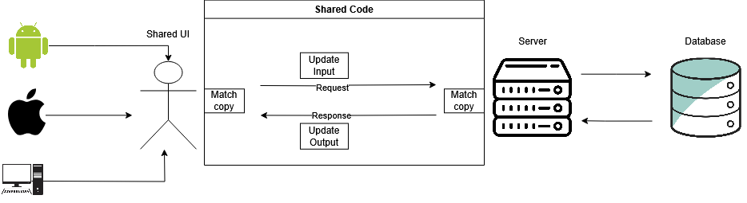
Architecture

Slide 5
Current Functionalities
Register/Login;
Check profile information;
Play against other users;
Check user match statistics.
Note:
These functionalities are currently working for Android, Browser and Desktop.
iOS and macOS was not tested due to the lack of equipment.

Slide 6
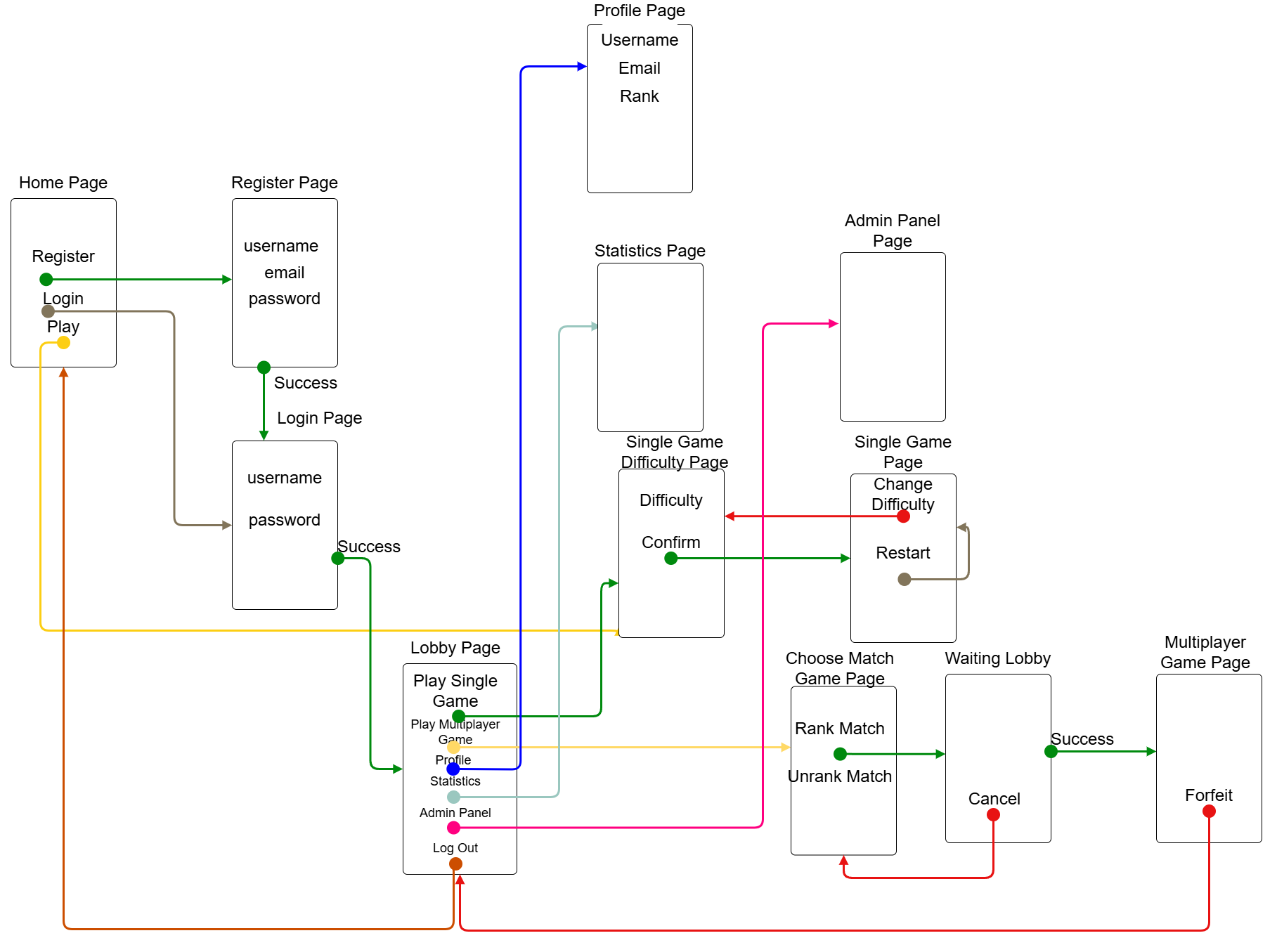
Navigation

Slide 7
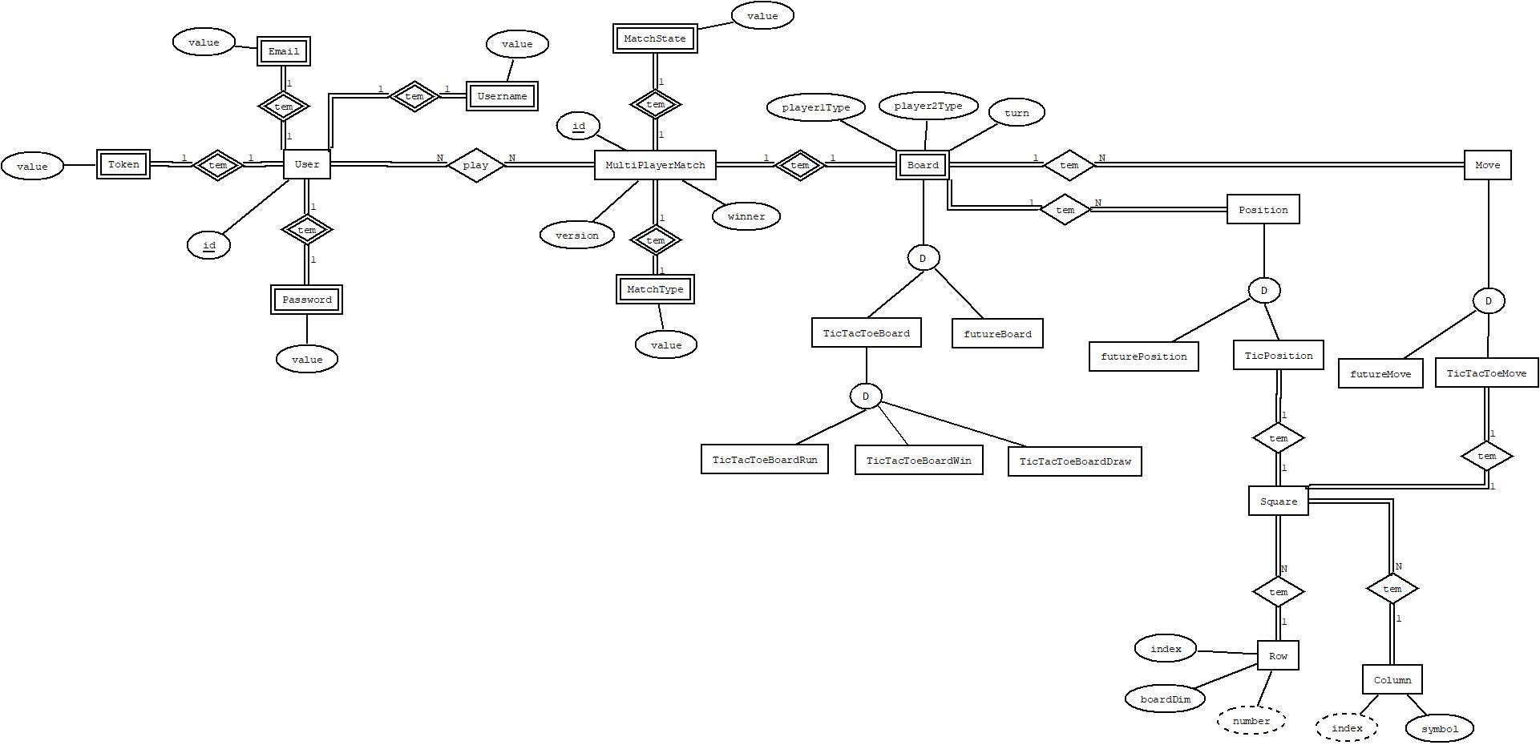
Data Model

Slide 8


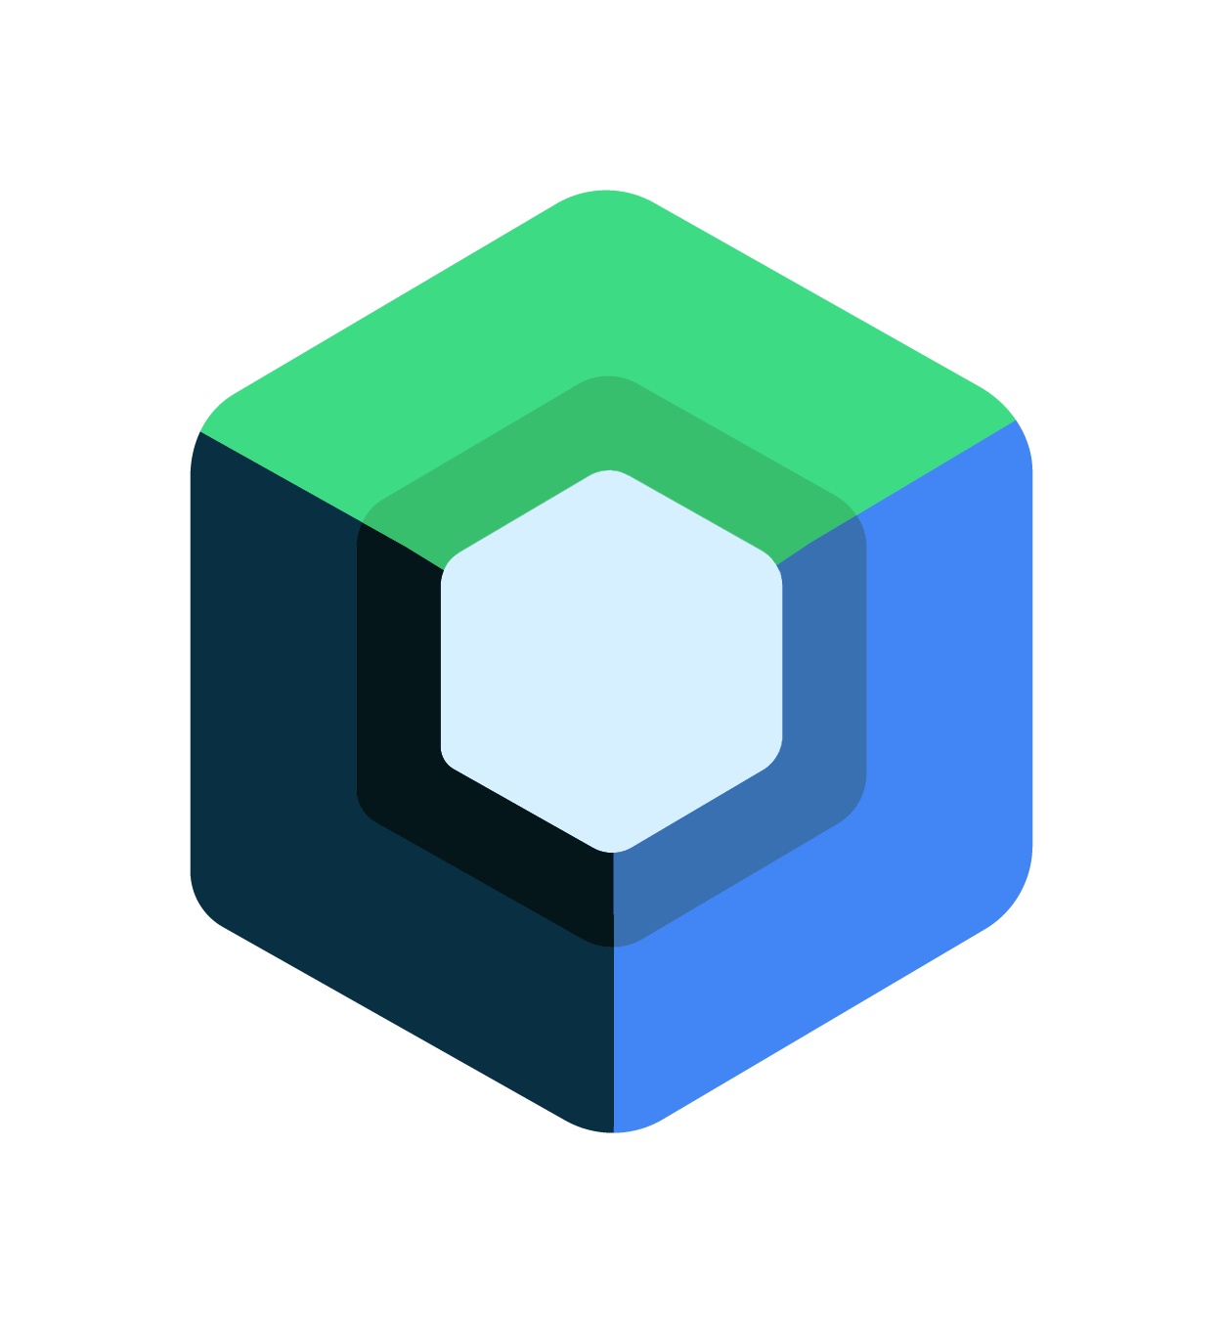

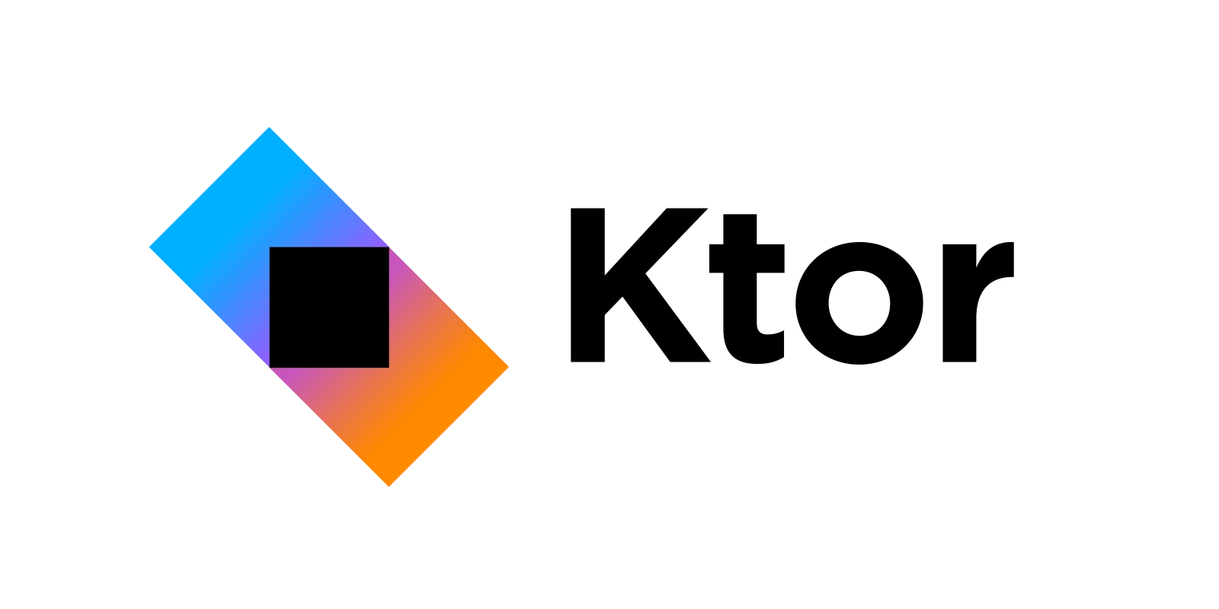
Technologies

Slide 9
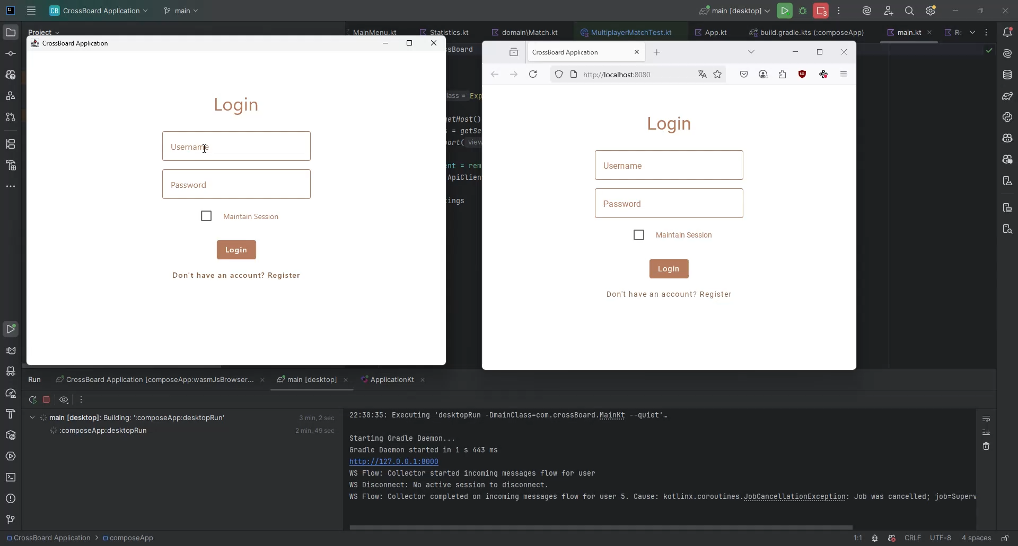
Demo

Slide 10
What’s left?
Implement single player functionalities;
Implement administration system;
Overall performance optimization
Support more games.

